Slide 1
Professional Practice
Development Assessment
Sebastian Anderson

Slide 2
Introduction
Introduction:
This assessment will cover the process of conducting research and developing an industry relevant professional development plan.
The provided brief is designed to collect all the evidence of competency required for this subject. Following an alternative brief and/or presenting additional evidence of competency needs to be negotiated with your trainer. Further information on the assessment process and requirements can be found in the unit’s subject and assessment guide.
The assessment will include:
A self-evaluation.
Conducting research into studios and products.
Research into key sources of industry relevant information.
Analysing job listings and determining industry requirements.
Creating a professional development plan.
Seeking feedback and evaluating career plans.
The assessment instructions:
All sections marked in green must be edited/filled out by each student. Be sure to replace “Student Name” on the first slide and include your name in the document filename.
All research sources must be current and valid and must be recorded in the relevant section of the assessment workbook.

Slide 3


Submission | Guidelines
The following files must be zipped and uploaded to Canvas for assessment. Ensure files are in appropriate folders. All folders and submitted files must adhere to the provided naming conventions. Naming convention is SubjectName_AssetName_FirstNameLastName.
Example folder structure is below:
Within each folder, please submit relevant files:
Professional Practice Development Folder
Professional Practice Development assessment workbook PowerPoint
ProfessionalPracticeDevelopment_FirstNameLastName
ProfessionalPracticeDevelopment_FirstNameLastName

Slide 4
Self-Assessment

Slide 5
Self-Assessment | Career Goals
Identify and describe three short term career goals and two long term career goals in the table below.
Question | Career goals
Clarify your first short term career goal. | I am currently apart of a small indie team in Games plus, My goal is to complete our current small project, and have it released so that I can build up a portfolio of high quality projects, that demonstrate I can work on games through all of the stages from start to finish. I would also like to continue to grow and expand the company and continue onto a second project
Clarify your second short term career goal. | I would like to work on extremely small and simple games that can be completed as a solo developer, (2–3-month projects of a mix of mobile games & small pc games) This would be also mostly for portfolio work, as well as to experience solo dev work, indie dev and hopefully one day triple A so that I can find which I like best and want to spend more time in.
Clarify your third short term career goal. | I would like to start working and developing a professional portfolio website with a list of projects I have worked on, that shows off my work in an interesting and entertaining way
Clarify your first long term career goal. | I would like to expand the Indie studio, have multiple completed projects with it, and slowly move on towards more complex projects and ideas
Clarify your second long term career goal. | I would like to get a Junior role at a large company preferably triple A, and for PC or console development, (companies such as Ubisoft, Blizzard, Riot, Creative assembly, EA and more) I would apply for junior level design positions, junior game design positions and potentially junior progression or economy design positions. I would be happy to and may even prefer to travel overseas for this opportunity.

Slide 6
Self-Assessment | Feedback
Discuss your career goals with your trainer and seek feedback and advice. Feedback will be given verbally by your trainer, take notes below and describe how you will address the feedback.
Feedback | Actions Taken Based on Feedback | Approved
The third short term goal – to get a junior game design role at a large company, is too large and will take much more time to achieve than the other two, and should instead be a long-term goal, instead use another short-term goal that you can achieve within the next year | I moved the short-term goal as a long-term goal instead and came up with a new short-term goal to replace it, - 'to create a website portfolio that can showcase my work in an interesting and entertaining way'

Slide 7
Self-Assessment | Soft Skills
Identify three soft skills that relate to your career goals and provide an example of how you could improve on each.
Soft skills | Examples of how you could improve on the soft skill
Communication & Collaboration | By actively seeking feedback for ideas, asking for others inputs and suggestions. Be more open towards listening to others and taking on their ideas, even if we disagree on things Actively seek out opportunities to present to others, and network with others
Problem solving | Brainstorming problems and potential problems that could come up during a project, come up with multiple solutions for each and write them down Ensure enough testing is done early in projects when it is easy to change things, problem solve and test different solutions to potential issues
Creativity | Write down and draw out game ideas, level and plans when they pop up, practice coming up with ideas and solutions for areas that I'm not already comfortable with, for example come up with games and levels for games or ideas that I would not play myself.

Slide 8
Self-Assessment | Technical Skills
Identify three technical skills that relate to your career goals and provide an example of how you could improve on each.
Technical skills | Examples of how you could improve on the technical skill
Documentation | Practice writing out and structing Game design documents, research new methods to better pace and describe a document for different roles, Read over other documentation and take notes to better understand structure, or things that my own documents may be missing.
Level Design | Practice building structures and environments from pictures on the internet, ensure scaling is done correctly through searching the internet, as well as pasting the character model around the screen as a reference Watch GDC videos and others discussing how professionals come up with their designs, and environments and what they consider in the design process, look up other designers portfolios on LinkedIn and other websites and see how they make their levels.
Game engine skills | Practice in engine skills such as coding, grey boxing, using lighting and particle effects, follow tutorials as well as attempt to make scenes or functions from other games without a tutorial as guide.

Slide 9
Industry Research

Slide 10
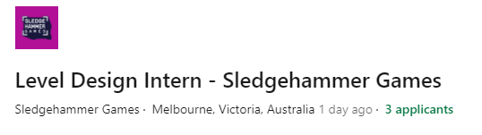

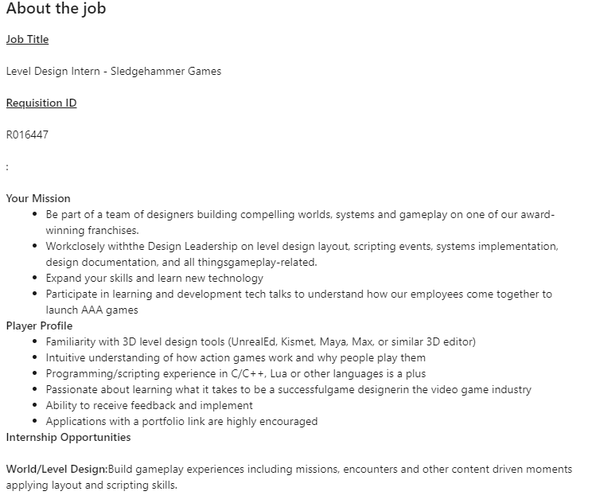
Industry Research | Job Advert 1
Research a job advertisement related to your career goals. Identify and list the soft and technical skills required.
Job advertisement soft skill requirements:
Communication
Understand and receive feedback
Creativity
Job advertisement technical skill requirements:
Level Design tools
Programming skills
Job Advert Screenshot

Slide 11
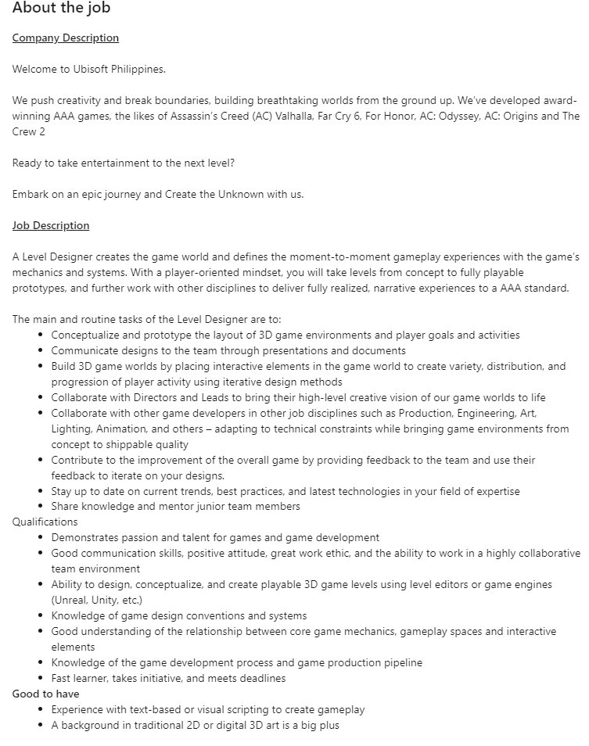
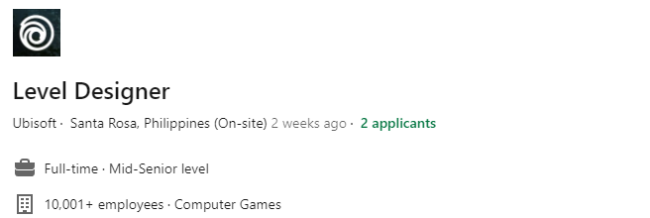
Industry Research | Job Advert 2
Research another job advertisement related to your career goals. Identify and list the soft and technical skills required.
Job advertisement soft skill requirements:
Communication
Teamwork & collaboration
Knowledge on trends / latest tech / games
Job advertisement technical skill requirements:
3D level editor skills
Game knowledge & mechanics
Design skills
Documentation skills
Text or visual scripting skills
Job Advert Screenshot

Slide 12
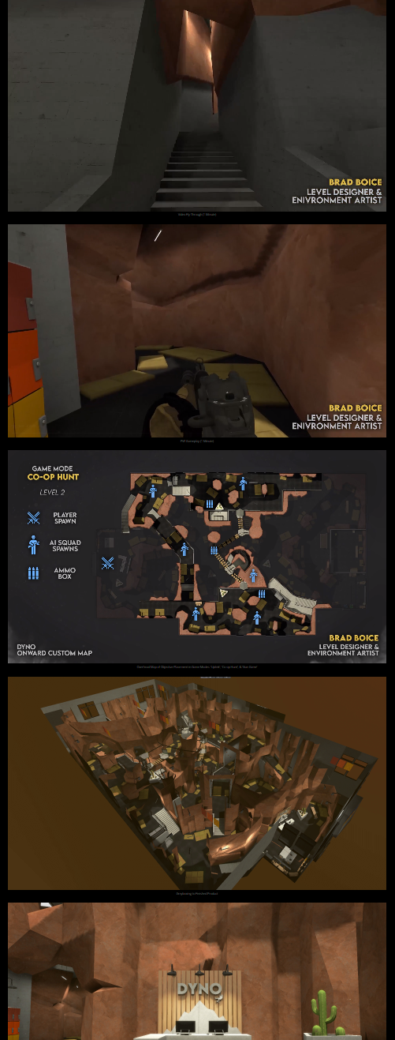
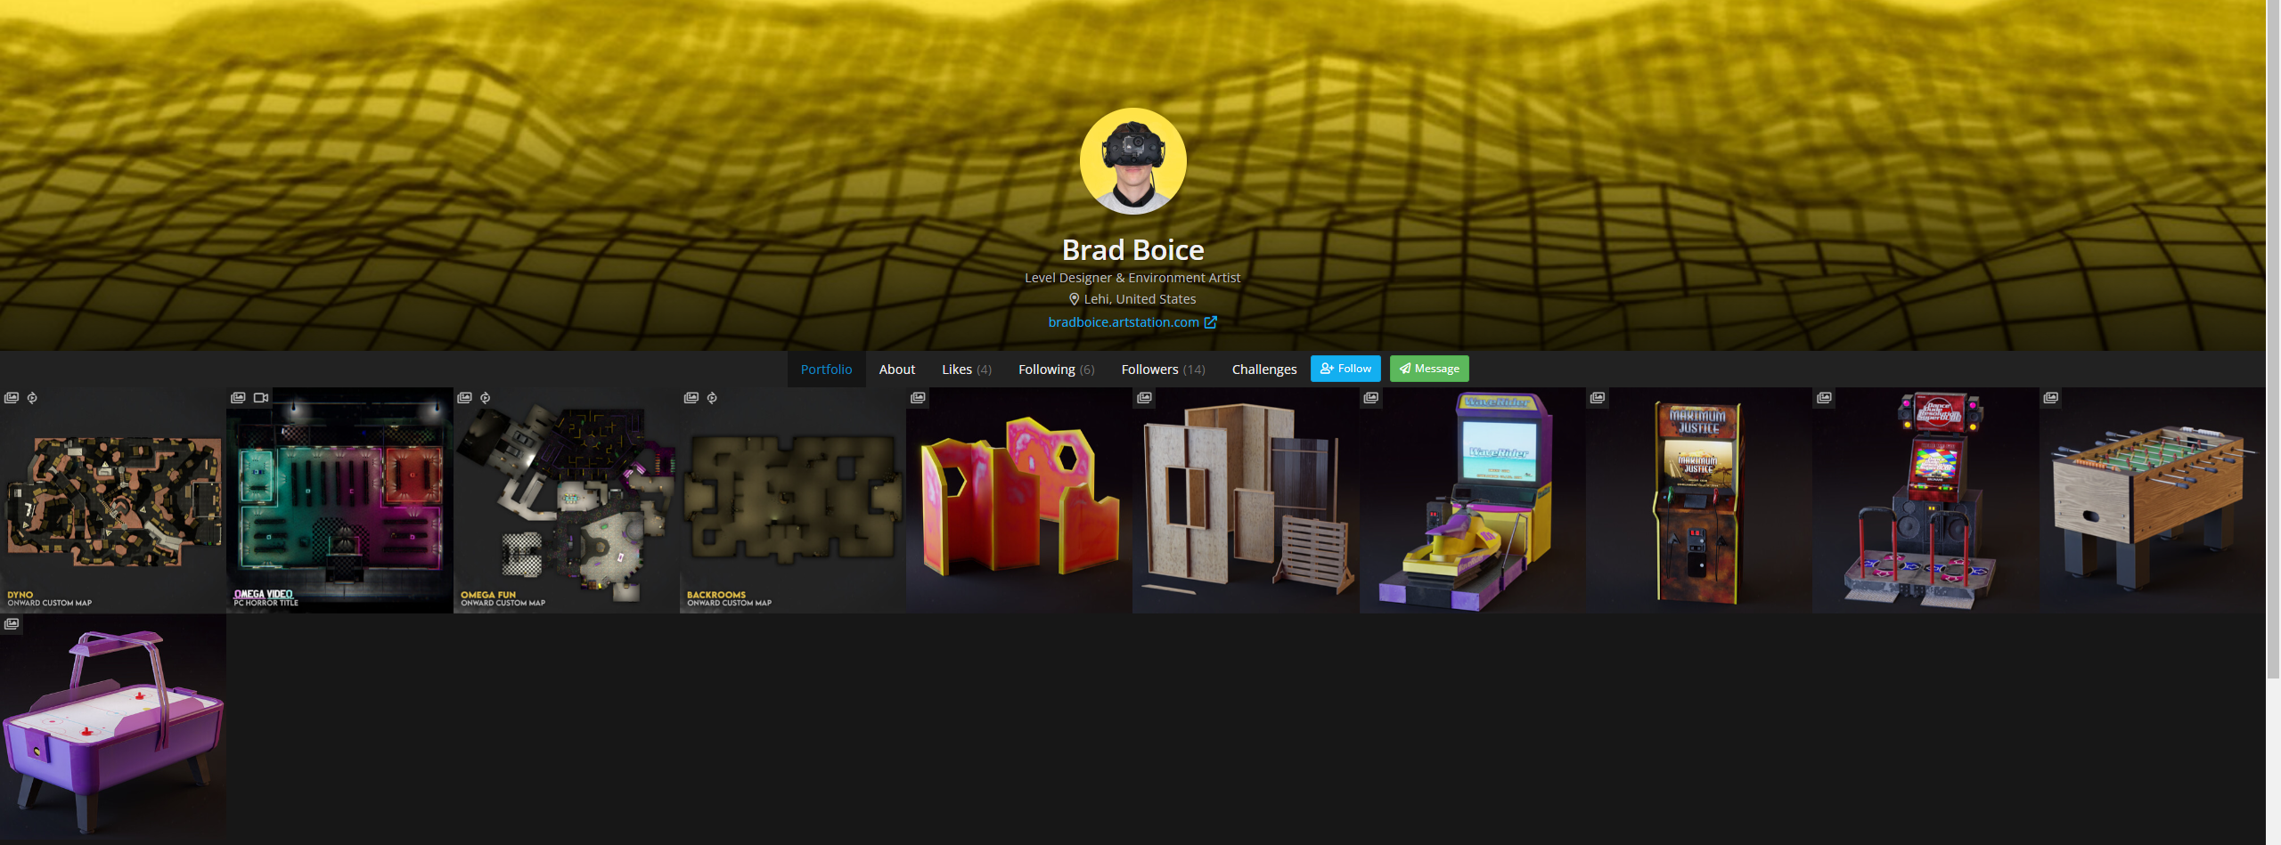
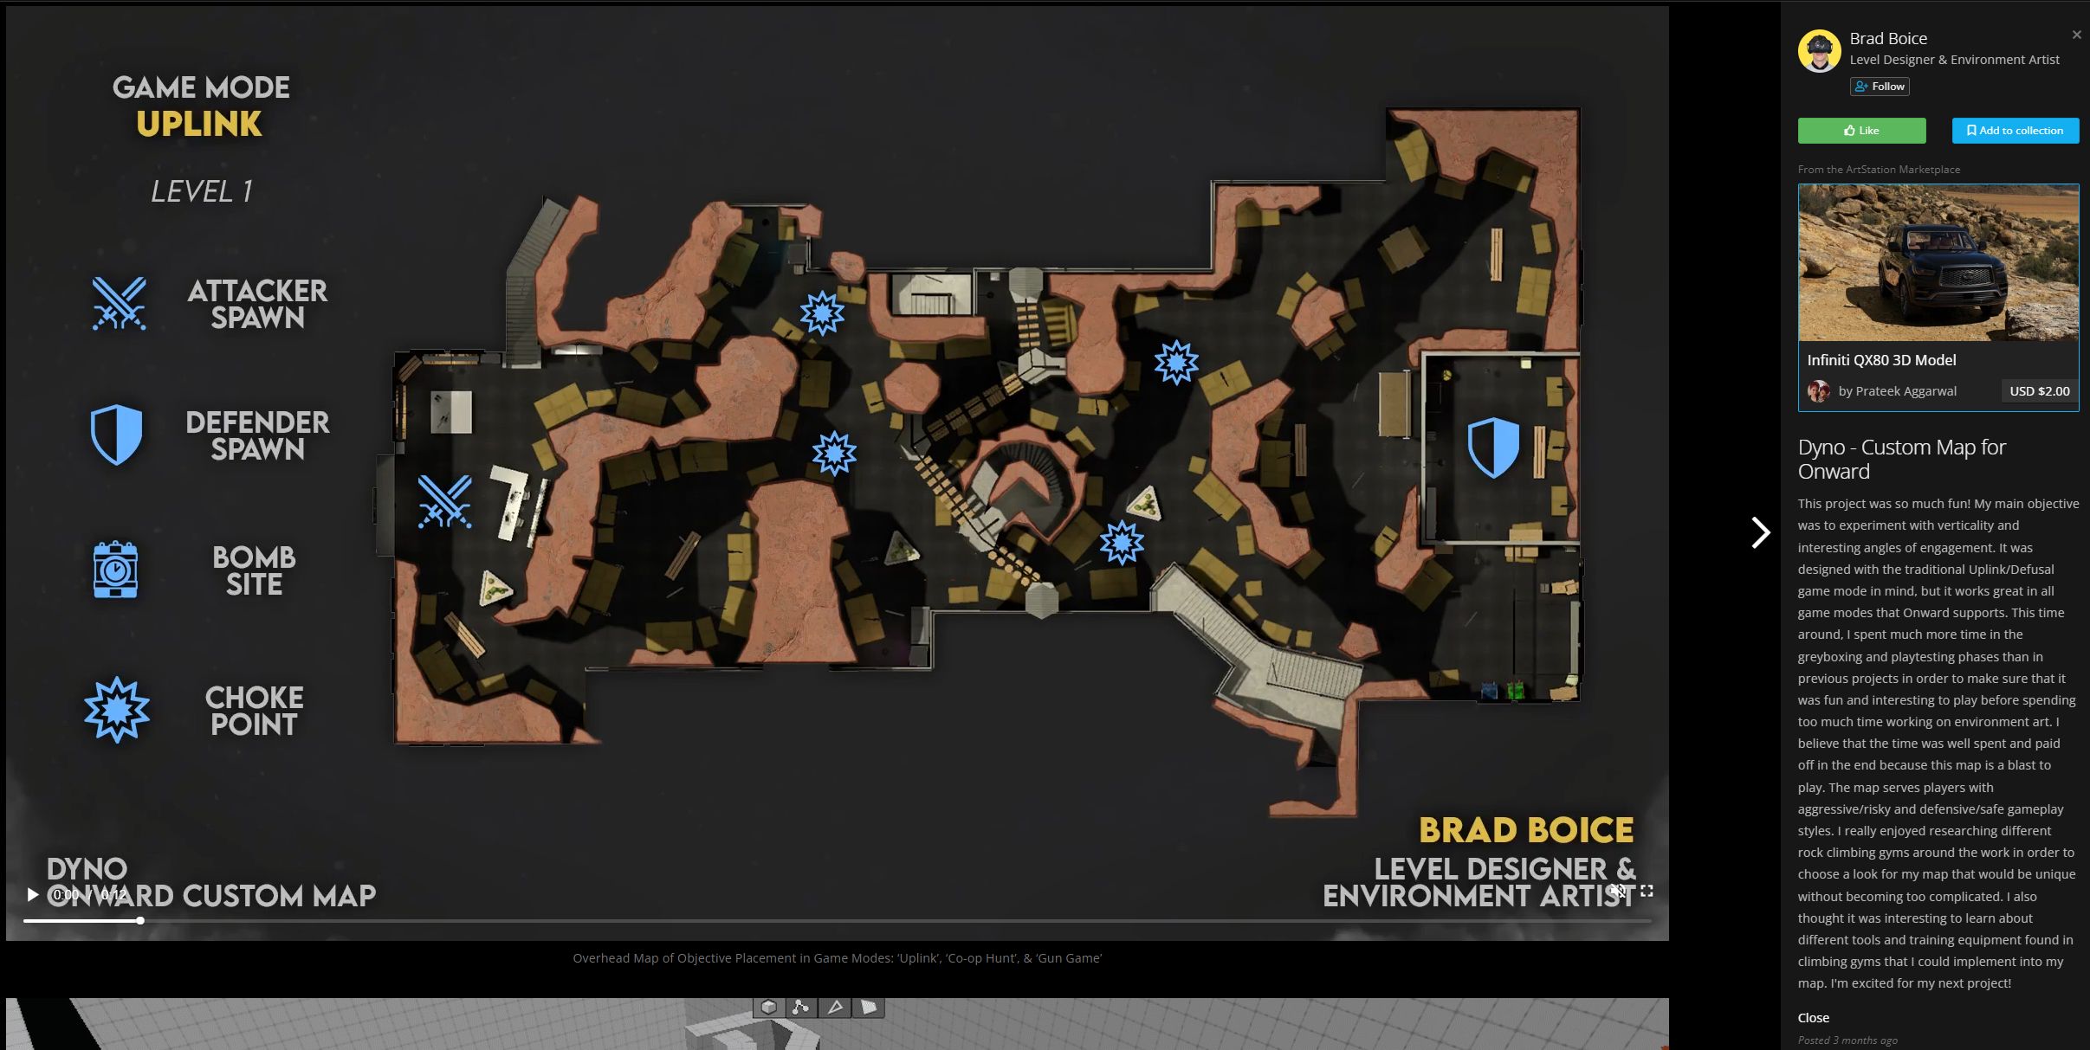
Industry Research | Portfolio 1
Research and analyse a portfolio of an industry professional that aligns with your career goals. List the software used and technical skill proficiencies demonstrated.
Software used to create the portfolio:
ArtStation
Photoshop
Video editing software – final cut pro
Technical proficiencies demonstrated:
Photoshop skills
Level Design skills
3D level editing software skills
Map design skills
3D art & modelling skills
Portfolio Screenshot

Slide 13
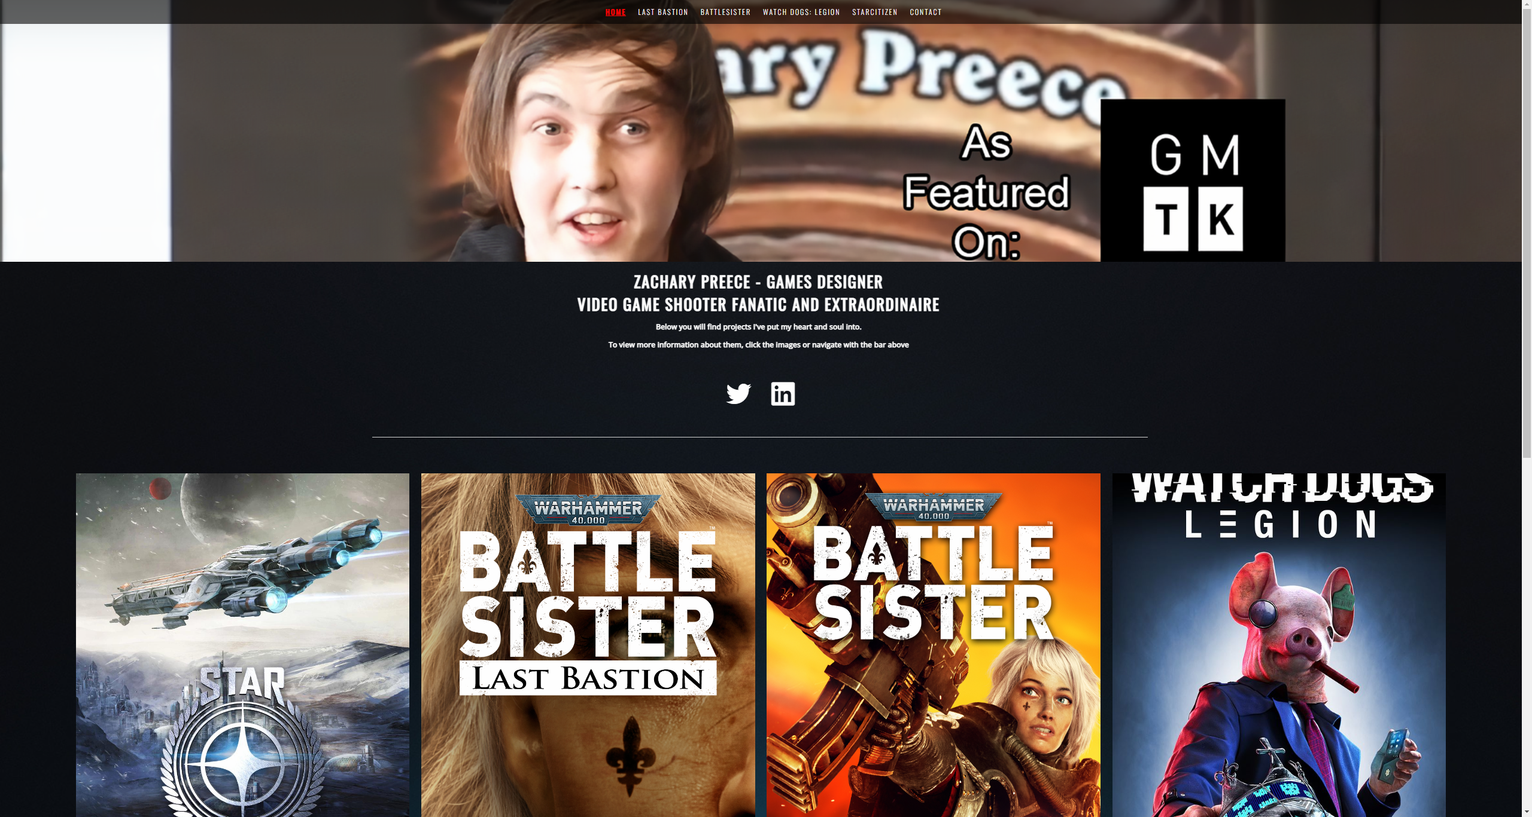
Industry Research | Portfolio 2
Research and analyse another portfolio of an industry professional that aligns with your goals. List the software used and technical skill proficiencies demonstrated.
Software used to create the portfolio:
Web developing site
Video editing – final cut pro
Technical proficiencies demonstrated:
Game Design skills
Testing and balancing
Character design and balancing
Zachary Preece Game Design portfolio

Slide 14
Industry Research | Local Company
Select and research a local studio/comapny and answer the questions below.
Questions | Answers
What is the name of the chosen company researched? | HalfBrick
How many employees work at the company? | 81 employees
Where is the studio located? | Brisbane, Queensland
When was the company founded? | 2001
Who are the key people of the company? | Shaniel Deo is the CEO of HalfBrick, Dan Vogt is a co founder of half brick and also Game Designer for the studio

Slide 15
Industry Research | Local Projects
Utilising the chosen local studio/company research and answer the questions below.
Questions | Answers
Identify a project the company has release including the release date? | Fruit Ninja, released on the 21st April in 2010
Who is the target audience? | HalfBrick referred to their audience for fruit ninja as the Casual Gamer, so the game is to be kept simple that anyone can pick up and play, as well as the game should be able to be described as simply as possible, “cut fruit and avoid bombs”
How successful was the project? Include sales figures if available. | Over 1 billion downloads today Extremely successful
How was the project received by the public? | Very well and still loved by many

Slide 16
Industry Research | International Company
Select and research an international studio/comapny and answer the questions below.
Questions | Answers
What is the name of the chosen company researched? | Paradox Interactive
How many employees work at the company? | 662 employees
Where is the studio located? | Stockholm, Sweden
When was the company founded? | Founded in 1998
Who are the key people of the company? | Peter Nicholson (Game Director), Stephen Muray (game director) Fredrik Wester (CEO)

Slide 17
Industry Research | International Projects
Utilising the chosen international studio/company research and answer the questions below.
Questions | Answers
Identify a project the company has release including the release date? | Crusader Kings III – release 1 September 2020
Who is the target audience? | Grand Strategy fans, Medieval History, 20+ age
How successful was the project? Include sales figures if available. | Has sold over 2 million copies, now also has DLC Quite successful
How was the project received by the public? | Crusader kings 3 has very positive reviews (around 90-93% positive on steam)

Slide 18
Industry Research | Knowledge
Research intellectual property rights, industry social issues, and emerging technologies and answer the questions below.
Explain why intellectual property regulations must be adhered to.
IP foresters and rewards originality, innovation and creativity, it acknowledges ownership and rights and stops people from stealing others creative projects
Research industry relevant social issue. Choose one and explain how the social issue is impacting the industry and suggest solutions.
Harassment of women in gaming, - Men think and act as if women cannot play games and harass them for it causing women to stop picking up and playing games
This is impacting the industry by reducing the number of players a game could have because women may be afraid to play due to the chance of getting harassed online
Implement systems into games that create better and friendlier communities
- Such as report systems or text chat moderation
Research industry relevant emerging technologies. Choose one and explain how it affects the industry.
Cloud Gaming – Where people can play games from home streaming the game off a cloud computer, this means that players will not have to continue to buy and upgrade their own hardware as the cloud computer would have the latest technology ready for any player to play on, this means that developers can start to push out better and better games without having to worry about toning down graphics or systems that would reduce performance on cheaper computers that a consumer may have

Slide 19
Industry Research | Industry Bodies
Research two industry bodies or associations and explain the how they can benefit your professional development. Focus on finding local groups that you have easy access to.
Industry Body/Association | Benefits
Interactive Games and Entertainment Association | A contract starter kit Discounted GCAP tickets Discounts for legal and accounting consultations with IGEA’s partners Webinars & workshops Government collaborations on investment and overseas market entry Access to shared working spaces Participation in Industry working groups
Games Plus | A Collaborative workspace for game developers, and a community where developers can collaborate and help each other, Game Plus provides a hub for digital entrepreneurs to co-locate, share resources, knowledge and opportunities. It’s also a focal point for government and industry to access a range of specialist expertise in interactive entertainment, simulation and training.

Slide 20
Industry Research | Industry Event
Research industry events for professional development. Choose an event that aligns with your career goals and estimate a budget to attend the event. This could be a conference or expo that hosts industry developers, speakers and community.
Find out the basic details of the event.
When is the event?
How much would it approximately cost to attend. Include ticket price, travel, accommodation and anything else needed.
Event name | Date | Ticket price | Travel expenses | Accomedation expenses | Other expenses | Total cost
PAX Aus | 7-9 October 2022 | $175 | $ 100 – fuel | $ 440 | $ 100 for food and other essentials stuff | $ 815
Write a short description of why it would be valuable to attend the event.
Answer here

Slide 21
Industry Research | Research links
Collect all the links used to gather industry information during your research, ensuring that they are current and valid and list them below.
Game Plus – AIE PAX Aus (paxsite.com) Join IGEA – IGEA Halfbrick Discover - Paradox Interactive ArtStation - Brad Boice Zachary Preece - Games Designer (zacpreece.com) Level Design Intern - Sledgehammer Games | Sledgehammer Games | LinkedIn

Slide 22
Professional Development Plan

Slide 23
Professional Development Plan | Network
List three current network contacts and how the contact can aid your professional development. These people may include family, friends, peers, trainers, work colleges, industry connections and other extended contacts.
Contact name | How are you connected | How can they aid in your professional development
Dan Beaumont | Teacher | Dan is teaching me Technical skills a designer needs in the industry as well as helping develop my soft skills required for the industry such as communication and acting on feedback
Jarrod Farquhar-Nicol | Community Manager of Games Plus | Jarrod is the community manager of Games plus with lots of industry connections, Jarrod can help me get connected with other game studios within Games plus area
Saxon Hutchinson | Industry Connection | Saxon is CEO of Kite shield Interactive, a small indie studio in Canberra, Saxon can help me learn and develop as a game designer in the Industry as he is currently working professionally in it.

Slide 24
Professional Development Plan | Networking
Develop a networking plan/strategy that will establish and expand your industry contacts. This could include internships, forums, social media, conferences, seminars, social meet-ups and events.
Networking Method | Elaborate on your strategy and explain how the new connection will help you professionally
Internship | I would love to do an internship at a professional Game studio, this will help tune my skills into something that the industry needs, as well as help build up needed soft skills such as communication and collaboration in the workspace.
Developing presence on Twitter | Actively posting work on linked in, for example a level layout and map, showing off some of the creative work that I can do, and build up a small following for it This would help my application get noticed by potential employees, show my dedication and passion for the job and be good practice of skills in my spare time. It will also help me learn to present levels and designs in a creative and interesting way that is engaging for viewers
Go to Events | Go to events around gaming, such as Gamma-con or PAX, as well as try to get a stall for the Indie studio, I recently went to gamma-con this year as an AIE student ambassador, and it was helpful to develop skills presenting to others, so going to more events like this would be a huge benefit, as well as being aware of what the industry is up to.

Slide 25
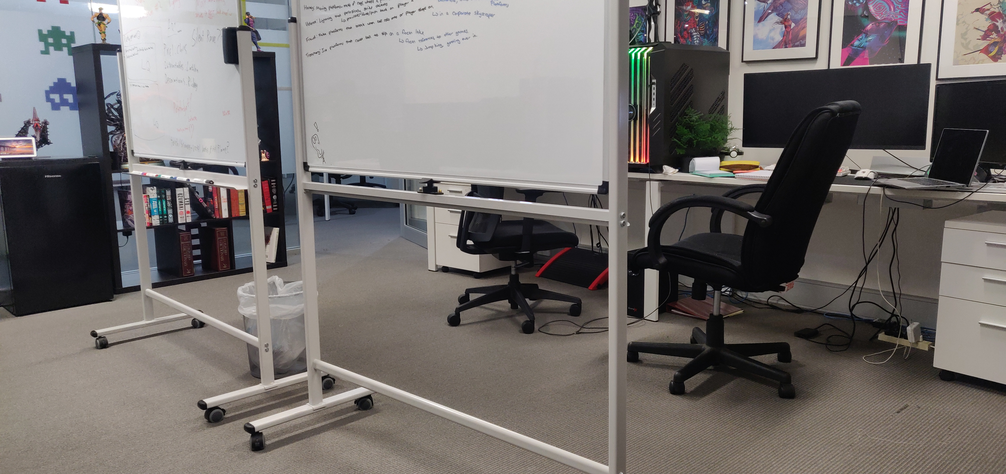
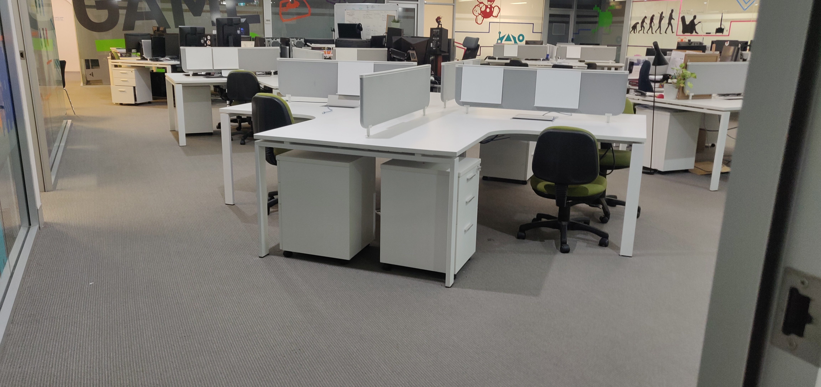
Professional Development Plan | Networking
Provide evidence of participation with an industry body or association. This could include a screenshot of joining the industry body or posting on the associations forum or social media.
Industry body or association name:
Games Plus
How did you participate with the industry body or association:
I am an active member in games plus Canberra and go to all their weekly events, I have an office space in their HUB, where I work everyday and spend time with the rest of the game plus community
Industry Body Participation Screenshot

Slide 26
Professional Development Plan | Career Plan
Define a career plan that identifies and outlines the milestones required to achieve your career goals.
Milestone | Date | Explanation of achievement and goal
Build up a decent portfolio of personal projects | 30/12/22 | Expand on my design portfolio by adding better design works that I have been working on In my spare time, taking advantage of all the knowledge already taught in class to create some prototypes as close to industry standard as possible, I would like at least 2 more highly detailed portfolio pieces of personal projects
Work on a simplistic solo project | 30/01/22 | Work on a very simple solo project, as a portfolio piece, either a short mobile game or a 10 to15-minute demo of a PC game. – something that can be shown as video form on a portfolio and looks good / captures attention.
Internship or Junior level design position or start advanced diploma | 30/1/22 | Either by 30/12/22 receive an Internship from a game development company or a junior level design position and if neither of those occur, I will move onto the advanced diploma course of Game Design next year
Release first game with Indie studio | 30/08/23 | By the end of February, hopefully the indie studio I am apart of will release its first game, giving me at the very least a great portfolio piece I can use to help get another job later
Finish Advanced Diploma / get job as a level designer | 30/12/23 | By the end of next year, I would like to have built up enough of a portfolio + completion of an advanced diploma to be ready to start applying for and receiving offers for Level Design jobs (from any studio worldwide)

Slide 27
Professional Development Plan | Feedback
Discuss your professional development plan with your trainer and seek feedback and advice. Feedback will be given verbally by your trainer, take notes below and describe how you will address the feedback.
Feedback | Actions Taken Based on Feedback
LinkedIn isn't a great platform for posting work (Level design layouts and maps) Instead work is much better received and shared on networking sites such as Twitter Milestone dates are a little unrealistic and will most likely require more time to be achieved while studying fulltime. | Changed the goal to develop a presence on Twitter and showcase work there instead Re wrote the milestone and gave myself more time to achieve them ( increased time frame by about 6 months)

Slide 28
Evaluation

Slide 29
Evaluation | Career Plan/Goals
Consider your career goals and the feedback you received and answer the questions below.
Question | Answers
Identify a weakness that may prevent you achieving your goals? | I lack good communication & networking soft skills, which makes it difficult to create connections in the industry and get myself out there
Identify a strength you have that will assist you in achieving your goals? | I'm dedicated to learning, and spend almost all my free time inside engine practicing techniques so that I can be more knowledgeable on the required software
What external constraints and limitations could prevent you meeting your goals? | I would like an internship or junior job at large game companies, but I currently live in Canberra, which makes applying for jobs more difficult as it can be expensive to move locations.
What is a short-term action item you could do to help achieve your goal? | Go to more networking events such as monthly pizza and pixels events to meet and connect with other game developers
What is a long-term action item you could do to help achieve your goals? | Work on more side projects that can be added to portfolio pieces, such as a 10-minute game demo or a simple mobile game.

